Slide 1
WaterSMART Basin Study Program

Slide 2
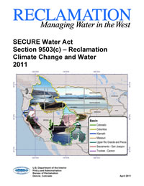
SECURE Water Act Section 9503
Directs the Secretary to establish a climate change adaptation program which includes
Assess risks to water supply
Analyze the impacts of changes in water supply on a variety of demands
Develop mitigation strategies in
consultation with non-Federal
participants
Notes:
-The Basin Study Program is authorized by Section 9503 of the SECURE Water Act, which was passed in 2009

Slide 3
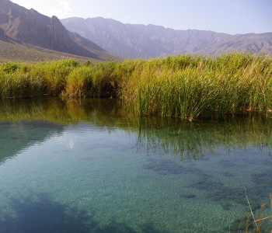
Basin Study Program Activities
West-Wide Climate Risk Assessments (WWCRA)
Apply a consistent approach throughout the west to assess impacts of climate change to water supplies, demands and operational risks
Basin Studies
Reclamation works on a cost-shared basis with state and local partners to develop potential adaptation strategies to meet future demands in light of imbalances in supply & demand
Landscape Conservation Cooperatives
Partnerships to develop applied science tools to help resource managers address landscape-scale threats.
Provides a forum to share information developed through the Basin Study Program and to benefit from complementary activities by other agencies

Slide 4
West Wide Climate Risk Assessments
Include projections and assessments of risks and impacts to water supplies, demands, and Reclamation’s operations due to climate change
Key baseline assessments leading towards more in-depth analyses performed through future Basin Studies
Streamflow Projections Website
http://gisweb.usbr.gov/Streamflow_Projections/
Provides future streamflow and water supply information at 195 locations across the west
Notes:
-WWCRAs are baseline assessments conducted by Reclamation in major river basins across the 17 western states
-provide climate change analysis that can be leveraged by stakeholders
-Includes a westwide assessment of future water supplies, water demands, and impacts to Reclamation’s operations
-west-wide supply projections currently available, west-wide agricultural demands projections to be released soon, and three Impact Assessments underway (Rio Grande, Sacramento-San Joaquin, and Columbia)

Slide 5
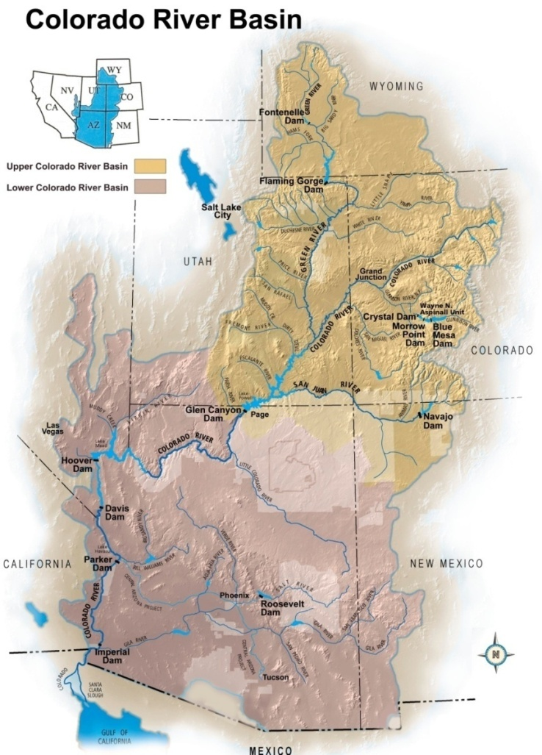
Basin Studies
Reclamation works collaboratively with non-Federal partners to evaluate current and future water supply and demand imbalances in a changing climate and identify adaptation strategies to meet future water demands.
Eligible applicants include States, tribes, water districts, cities, and other local governmental entities with water delivery or management authority located in the 17 Western States
Require 50/50 cost-share
Not Financial Assistance
Notes:
-non-Federal cost share can be cash or in-kind services
-because they are not financial assistance Reclamation funding can only be used for work performed by Reclamation or its contractors
-FY14 selection process expected to be initiated by the end of November

Slide 6
Basin Studies – 2015 Selection Process
Fiscal year 2015 selection process expected to be initiated in the fall of 2014
President’s budget request includes approximately $2 million in funding for Basin Studies
Studies are selected through a 2 step competitive process
Step 1 – Letters of Interest
Letters of Interest are submitted to Reclamation regional offices
Regional offices select which Letters of Interest will move forward to step 2 of the selection process
Step 2 – Proposals
Applicants work with Reclamation to develop a joint study proposal to submit to Policy and Administration
Proposals are reviewed and scored based on identified evaluation criteria by an application review committee made up of Reclamation staff

Slide 7
Basin Studies
4 Required Elements
Projections of water supply and demand, including the risks of climate change
An analysis of how existing water and power infrastructure and operations will perform in response to changing water realities
The development of adaptation and mitigation strategies to supply adequate water in the future
A trade-off analysis of the strategies identified, and findings and recommendations as appropriate

Slide 8
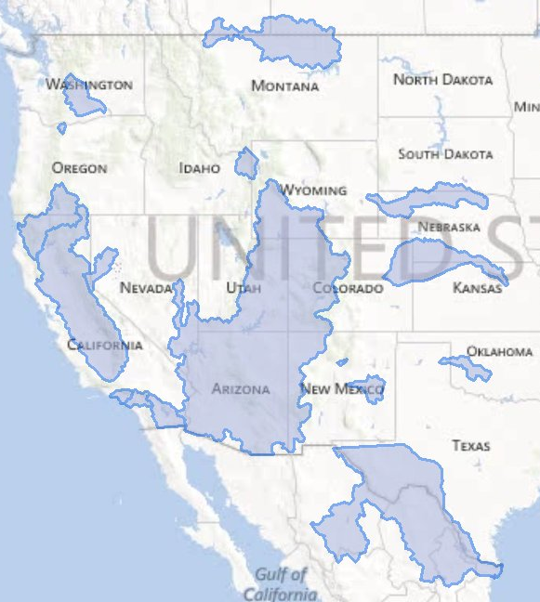
Funded Basin Studies
22 Basin Studies funded since 2009
2009
Colorado River Basin
Milk/St. Mary Rivers Basin
Yakima River Basin
2010
Niobrara River Basin
Truckee River Basin
Santa Ana River Basin
Henrys Fork of Snake River
S.E. California Regional Basin
2011
Lower Rio Grande River Basin
Santa Fe Basin
Klamath River Basin
Hood River Basin
2012
Upper Washita River Basin
Sacramento-San Joaquin Rivers
Republican River Basin
Pecos River Basin
L.A. Basin
2013
San Diego Watershed
West Salt River Valley
2014
Upper Red River Basin
Missouri River Headwaters
Upper Deschutes River Basin
Notes:
-2013 studies not pictured on map because study areas have not been finalized

Slide 9
Funded Basin Studies
4 Basin Studies are located in Southern California
2009
Colorado River Basin
Milk/St. Mary Rivers Basin
Yakima River Basin
2010
Niobrara River Basin
Truckee River Basin
Santa Ana River Basin
Henrys Fork of Snake River
S.E. California Regional Basin
2011
Lower Rio Grande River Basin
Santa Fe Basin
Klamath River Basin
Hood River Basin
2012
Upper Washita River Basin
Sacramento-San Joaquin Rivers
Republican River Basin
Pecos River Basin
L.A. Basin
2013
San Diego Watershed
West Salt River Valley
2014
Upper Red River Basin
Missouri River Headwaters
Upper Deschutes River Basin
Notes:
-Combined, these four projects impact nearly 20 million people in an area covering nearly 13,000 square miles

Slide 10
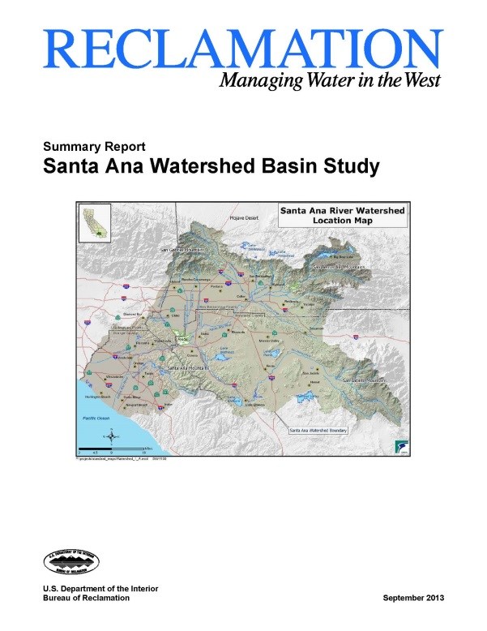
Santa Ana River Watershed Basin Study
Partner
Santa Ana Watershed Project Authority (over 350 water and related interests)
Goals:
Assist in the update of the basin’s integrated
regional water management plan known as
OWOW - One Water One Watershed Plan
Refine the region’s water supply and demand
projections and address potential impacts of
climate change and identify adaptation
strategies
Assess the water sector’s greenhouse gas emissions and expand outreach to water users and basin stakeholders
Population/Area Impacted
Over 6 million people in an area covering about 2,650 square miles including a number of disadvantaged and Native American communities.

Slide 11
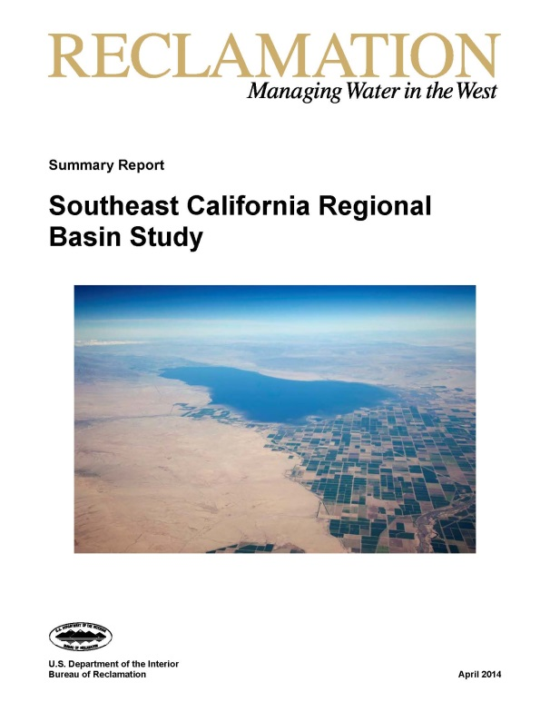
Southeast California Regional Basin Study
Partners
Borrego Water District; and Interests: Imperial
Irrigation District, Coachella Valley Water
District, San Diego County Water Authority
Goals:
Analyze structural options that could potentially resolve water supply-demand imbalances
Identify non-structural options that could improve water conservation or the ability of existing facilities to convey or store water
Address potential impacts of climate change and identify adaptation strategies
Develop strategies to ensure future water supply and demand are met
Population/Area Impacted
Over 750,000 people in an area covering nearly 5,200 square miles

Slide 12
L.A. Basin Stormwater Conservation Study
Partners
Los Angeles County Flood Control District and 21 local partners
Goals:
Evaluate the long-term potential of existing flood control dams, reservoirs, spreading grounds, and other facilities to conserve increased amounts of stormwater
Analyze structural and non-structural options that could potentially resolve water supply- demand imbalances
Address potential impacts of climate change and identify adaptation strategies
Population/Area Impacted
Over 10 million people (about 25% of the state’s population) in an area covering nearly 1,900 square miles

Slide 13
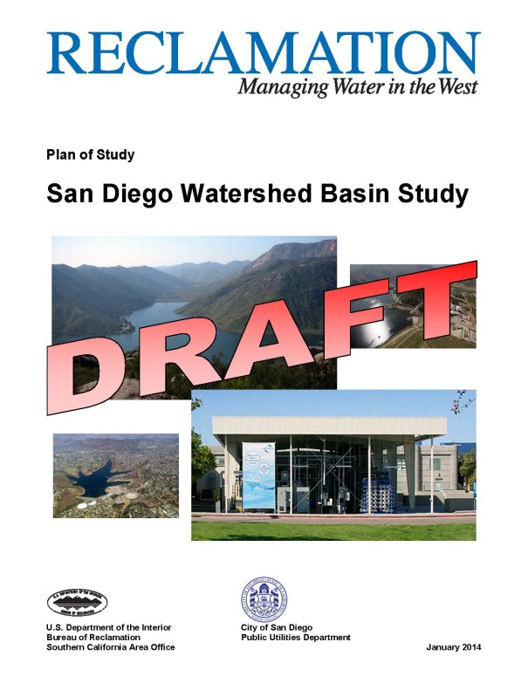
San Diego Watershed Basin Study
Partner: City of San Diego Public Utilities Department
Goals:
Evaluate the long-term potential of the existing water supply and storage infrastructure to address long-term water requirements
Analyze operational changes or modifications to existing facilities that could optimize storage capacity of reservoir systems
Assess proposed facilities (desalination and indirect potable reuse) that could potentially resolve water supply-demand imbalances
Address potential impacts of climate change on water supplies and identify adaptation strategies
Population/Area Impacted
Over 3 million people and 11 watersheds in an area covering about 2,900 square miles

Slide 14
Landscape Conservation Cooperatives
Reclamation co-leads 2 LCCs with FWS that encompass the Colorado River Basin
Desert LCC and Southern Rockies LCC
Reclamation provides funding for applied science grants in these two LCCs
LCCs in California include:
Desert
California
North Pacific
Great Basin

